Slide 1

By Michelle Goodman
michellegoodman@hotmail.co.nz
michelle.goodman@canterbury.ac.nz

Slide 2

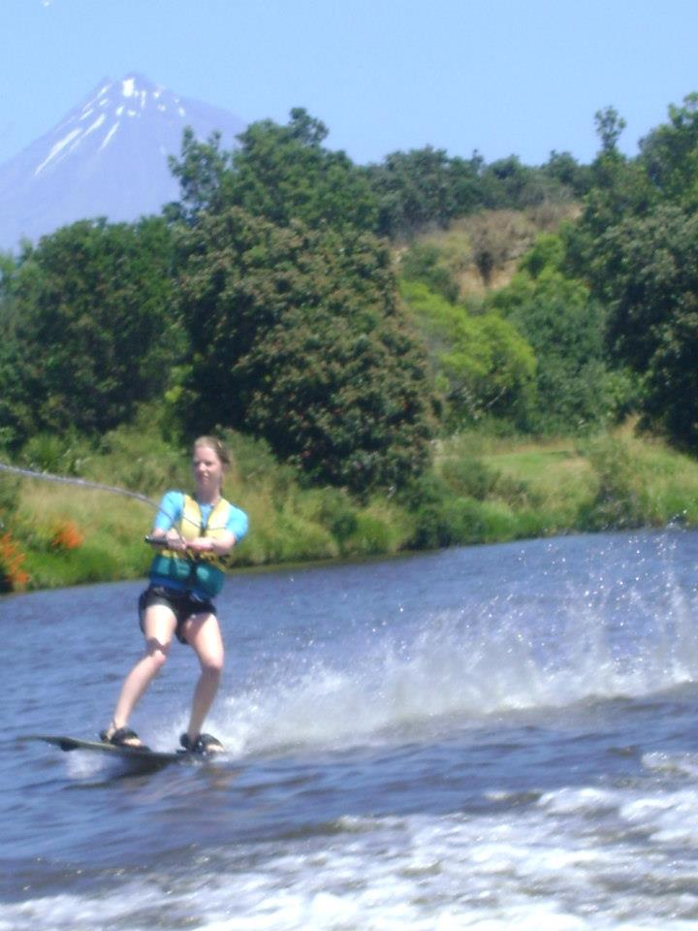
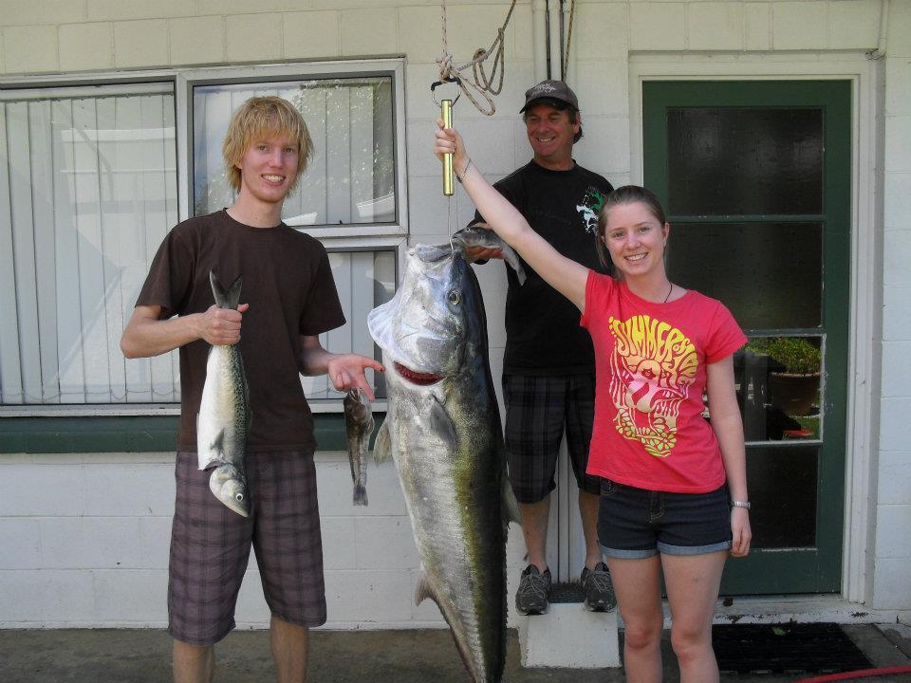


Slide 3
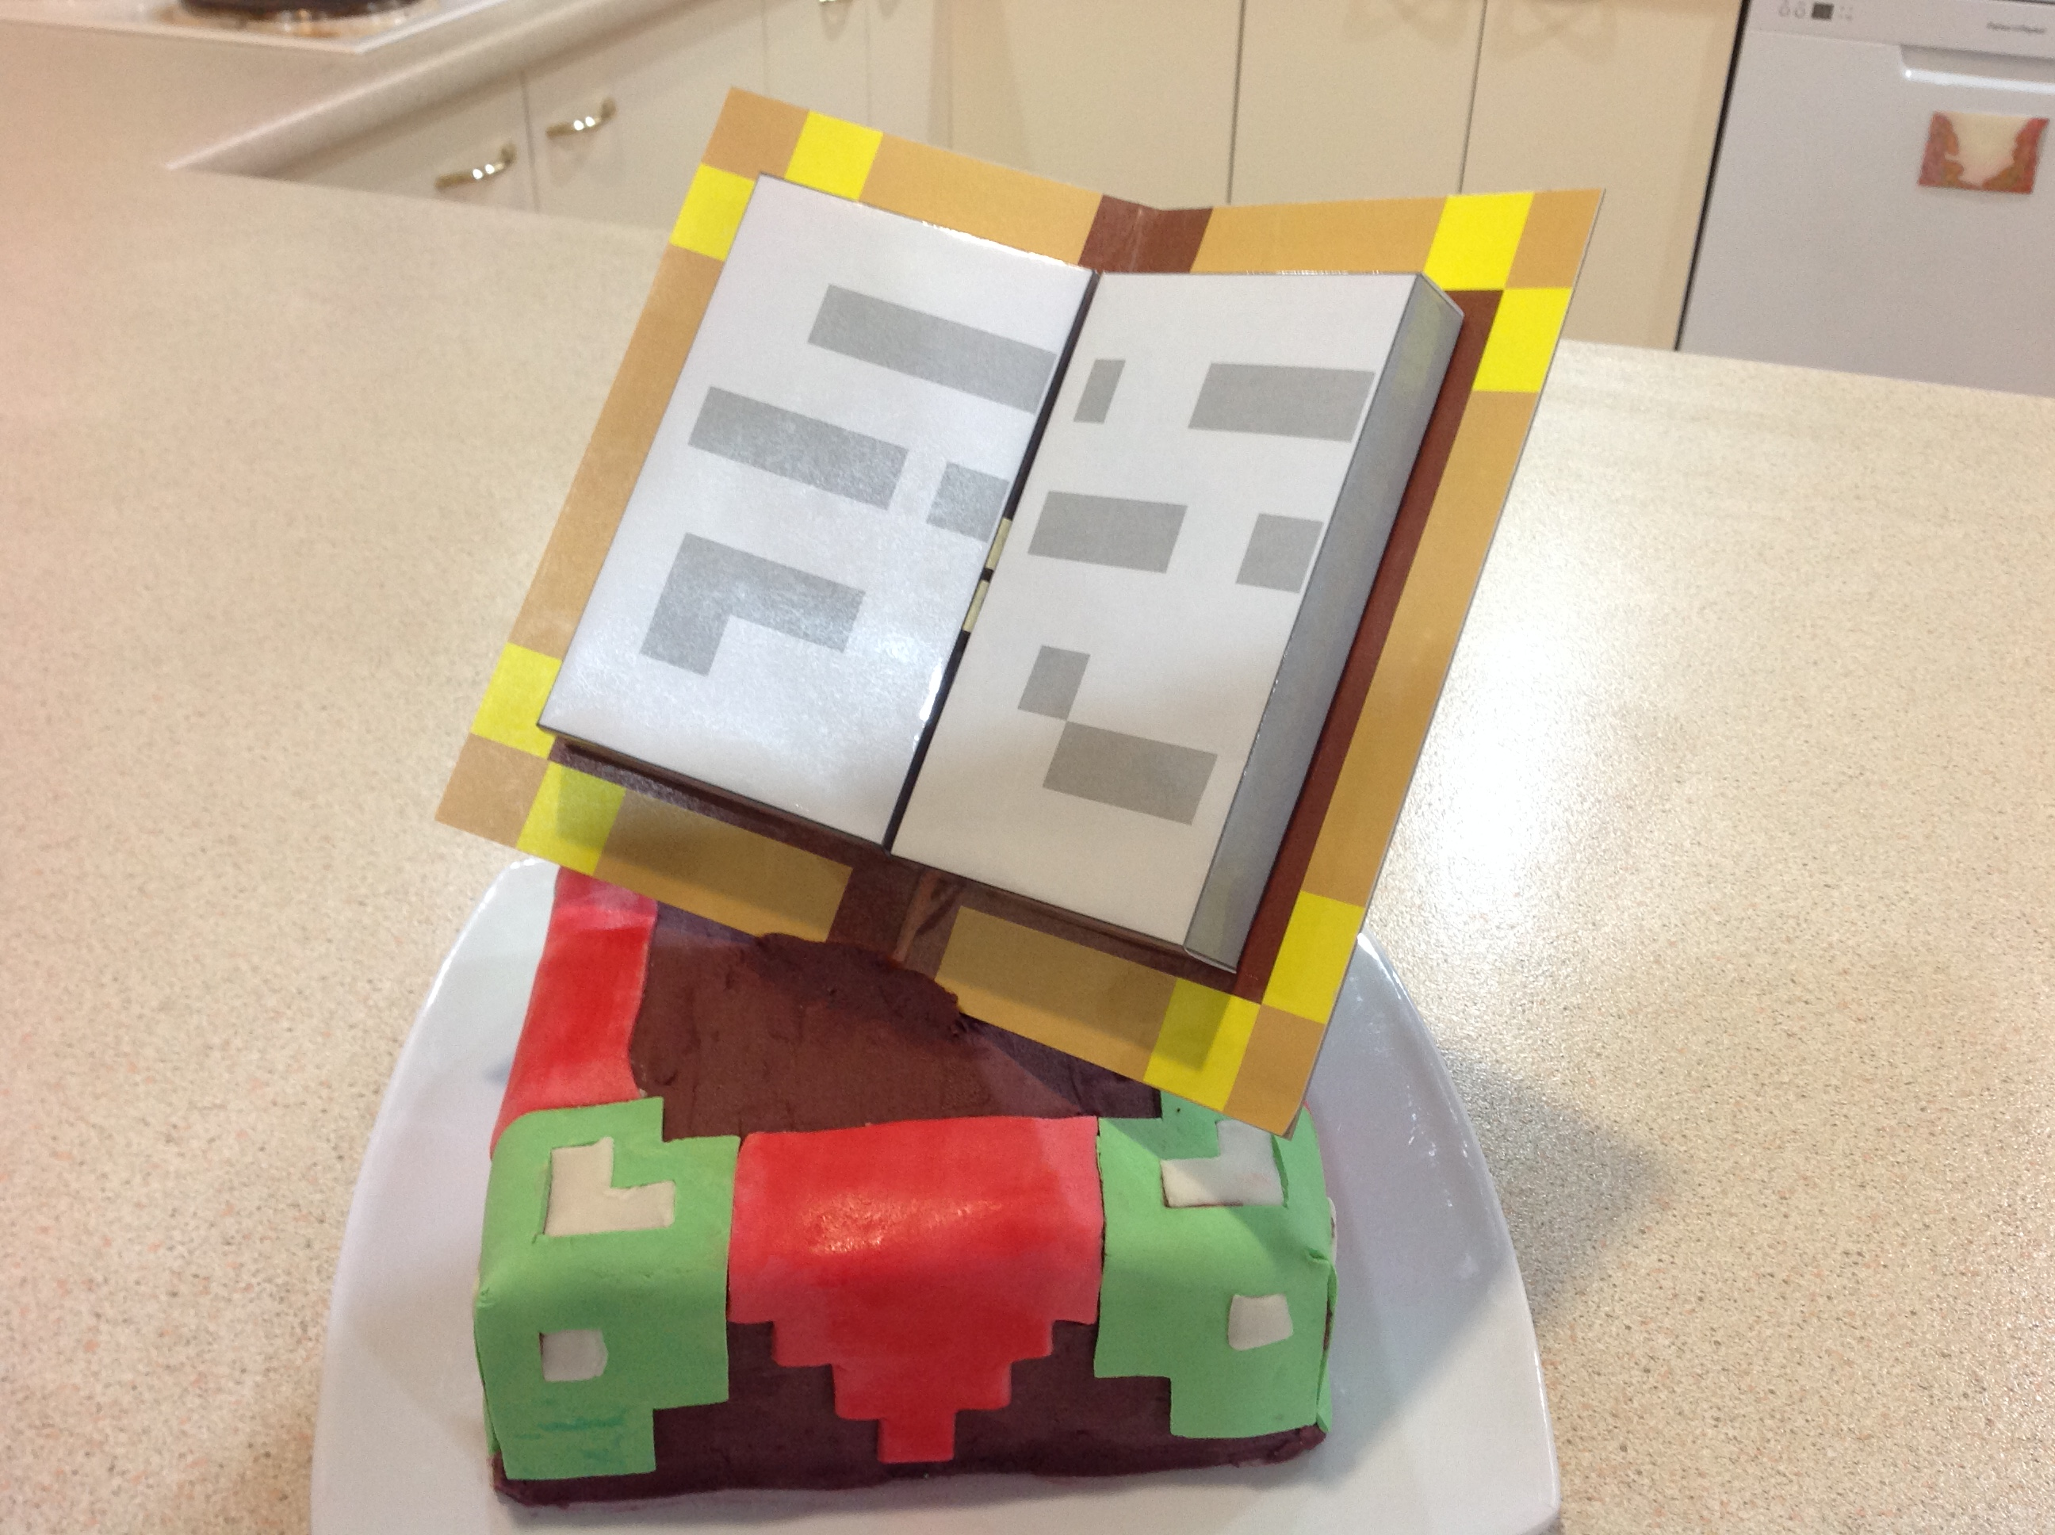
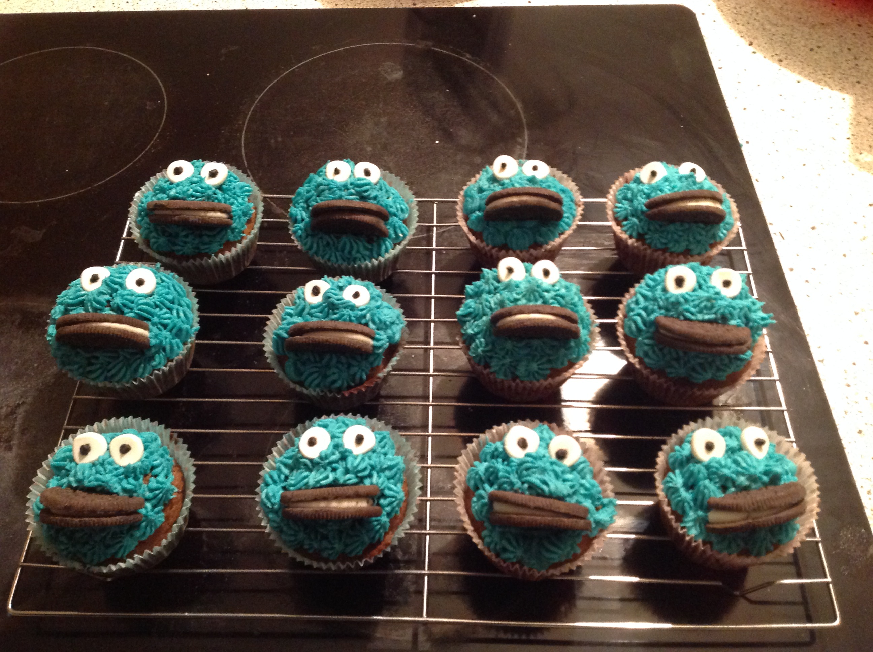

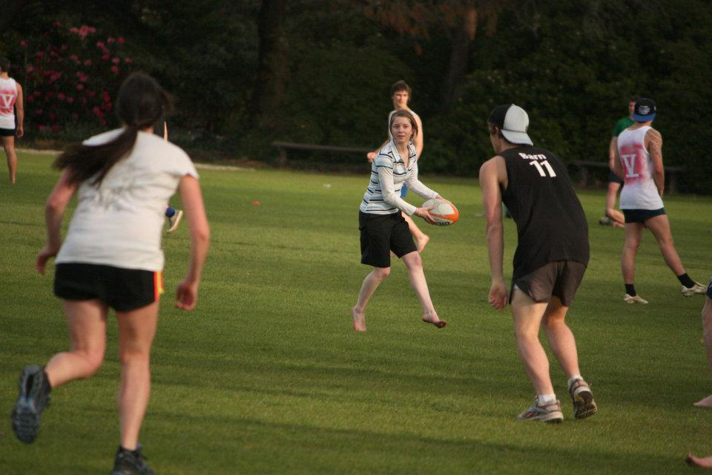
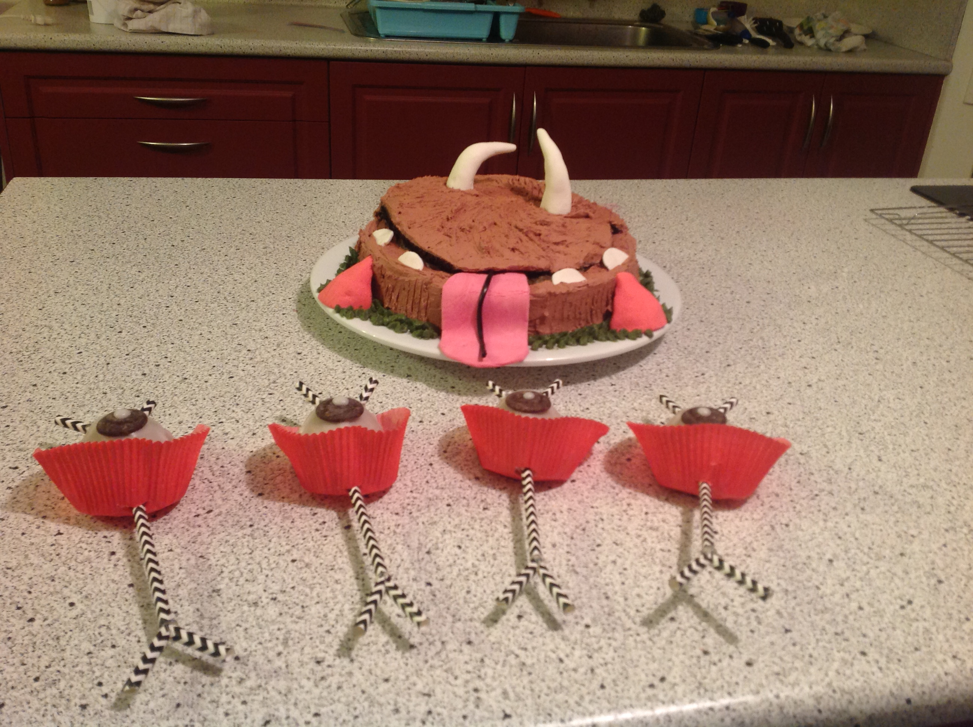

Slide 4


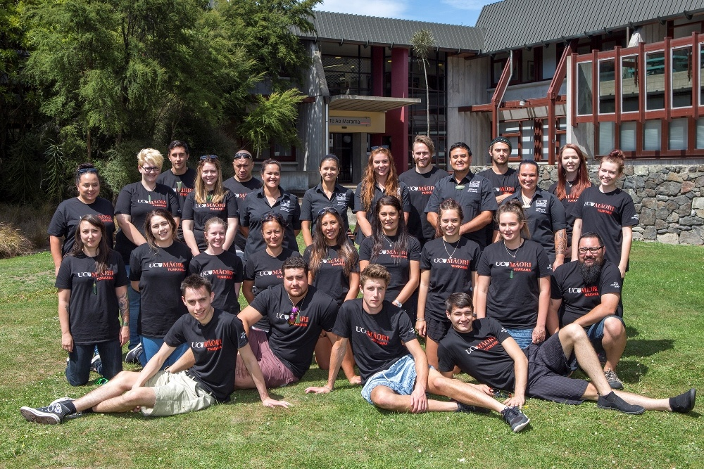


Slide 5
Scholarships and Awards:
Prime Minister Scholarship Asia (PMSA)
Postgraduate Research:
Ngata Centenary Doctoral Scholarship 2015
BRNZ Top Up Scholarship 2017
Health Research Society Canterbury (HRSC) Rutherford Prize for best presentation at Grand rounds 2016
R.H.T Bates Scholarship 2016 from the Royal Society of New Zealand
Prize in departmental promotional video competition
Travel Funding:
BRNZ Travel Grant 2016,
Fields Institute Conference funding 2017
SIAM Student Travel Award 2016
Te Punenga Grant 2016
During Undergraduate:
Society of Petroleum Engineering (SPE) Scholarship 2013
Vice Chancellor's Excellence Award 2013
Prior to 2010 and small awards neglected
Work History:
University of Canterbury International College,
Statics Mechanics Lecturer -3 months
University of Canterbury Maths Department
Maths Tutor -6 years
STOS (Shell Todd Oil Services)
Internship: Māui B production platform well Pressure Investigation.
Tenix, Fabrication Workshop
Internship: Pressure Vessel Quality Assurance
HOME; High-end furniture store
Sales Assistant
Sunworld Chinese Restaurant
Waitress

Slide 6
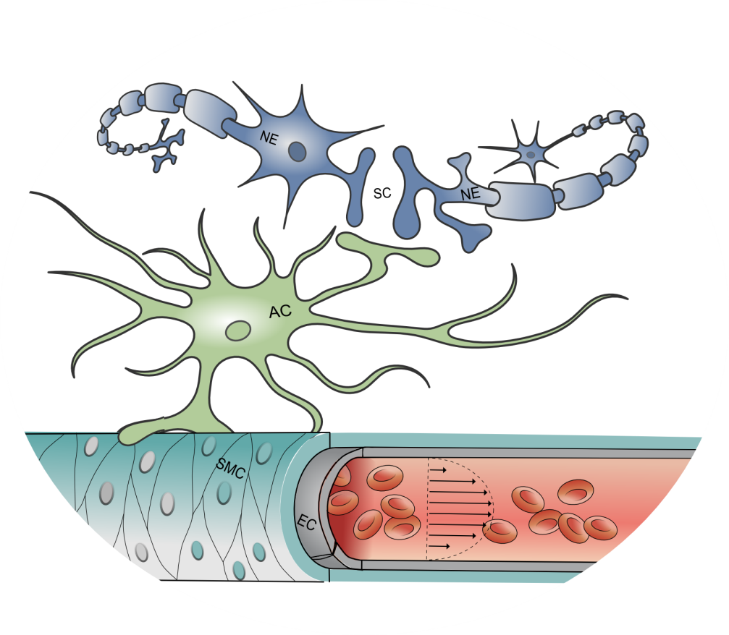

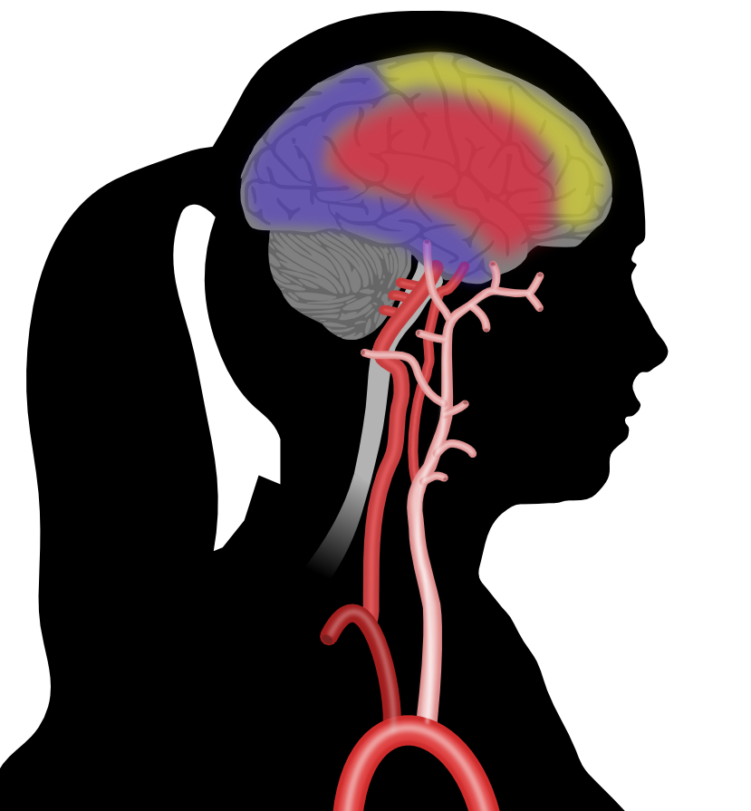
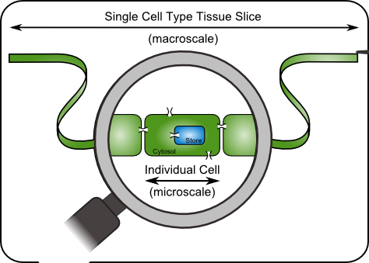
My PhD in 2 Mins

Slide 7
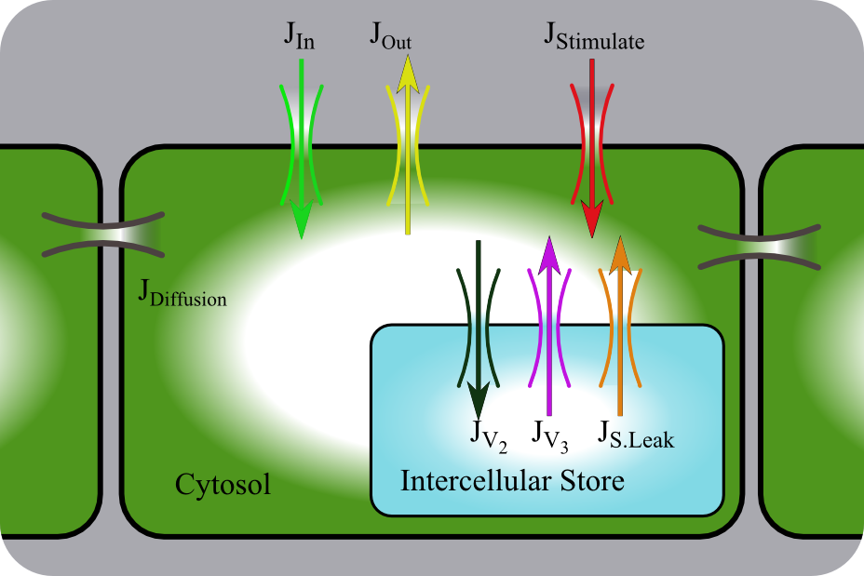
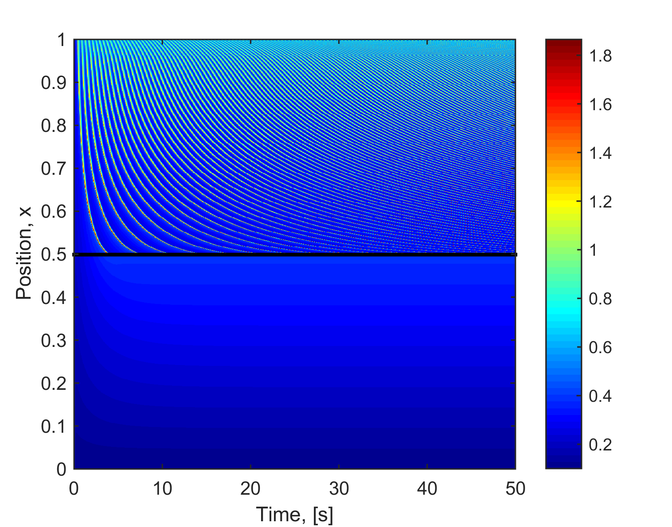
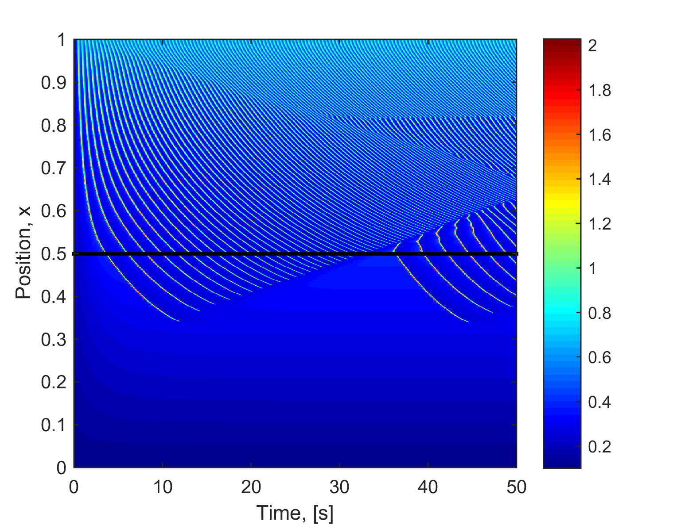
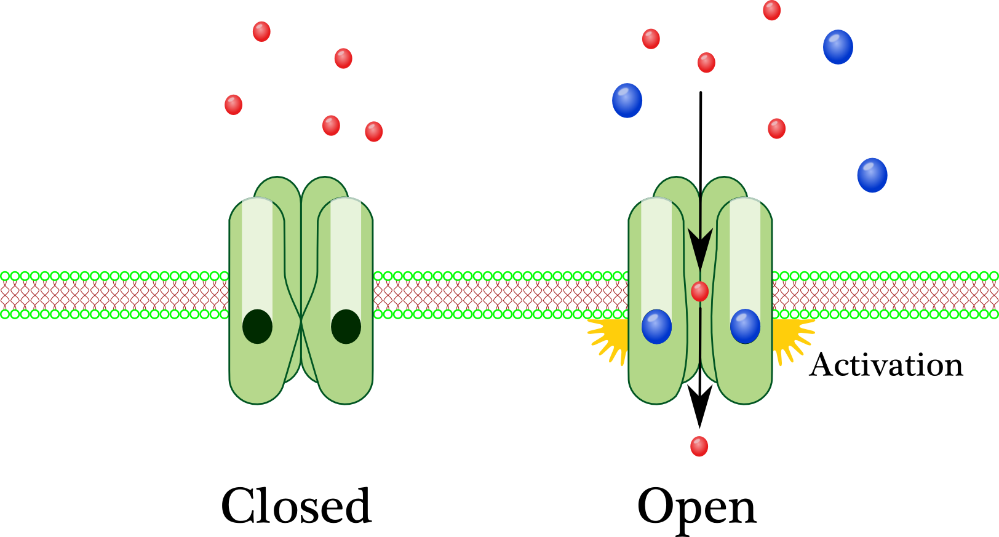
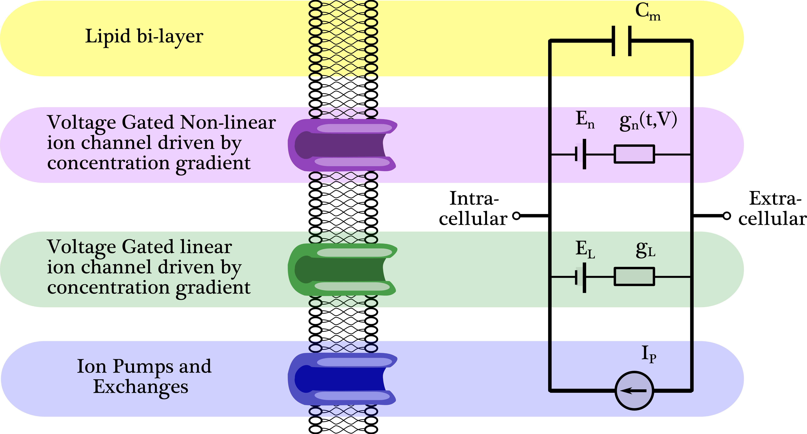
Moderate
Stimulus
No Diffusion
Spatial Position
Low
Stimulus
Diffusion
Moderate
Stimulus
Spatial Position
Low
Stimulus

Slide 8
Modification Of Surface Stability Equation To Suit Red Blood Cells With HS
Problem
Red Blood Cell Context
Possible Solutions
Conclusion

Slide 9
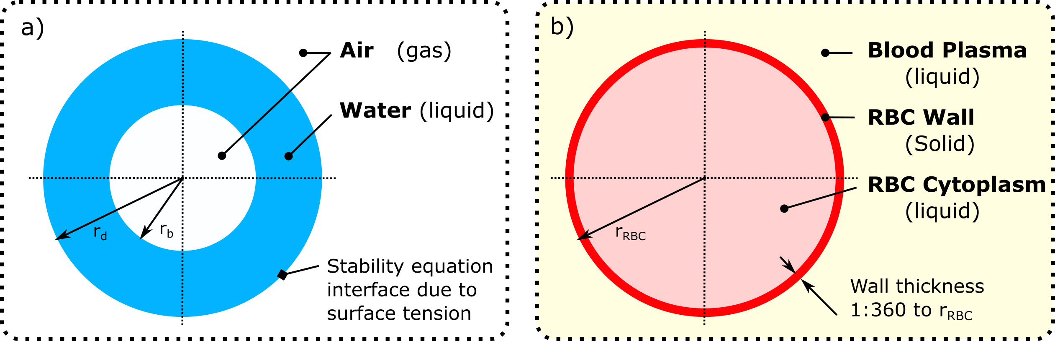
Problem
1. Problem 2. Red Blood Cell Context 3. Possible Solutions 4. Conclusion
Surface Stability Equation
or
Amplitude of Perturbation Equation

Slide 10
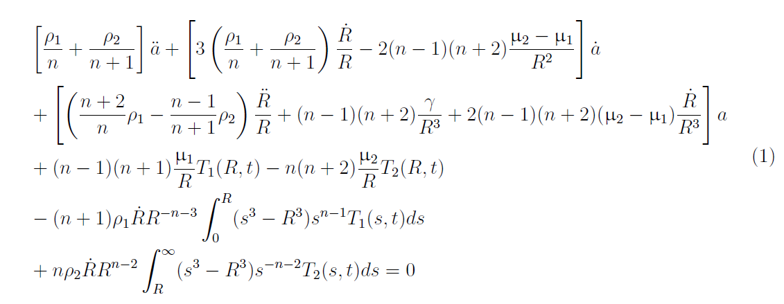
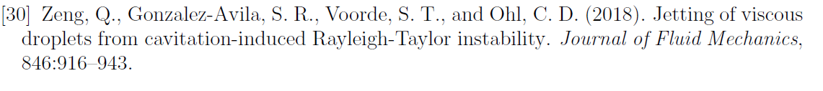
Surface Stability Equation
1. Problem 2. Red Blood Cell Context 3. Possible Solutions 4. Conclusion
Navier-Stokes equations and incompressibility conditions
Surface Stability Equation
or
Amplitude of Perturbation Equation

Slide 11
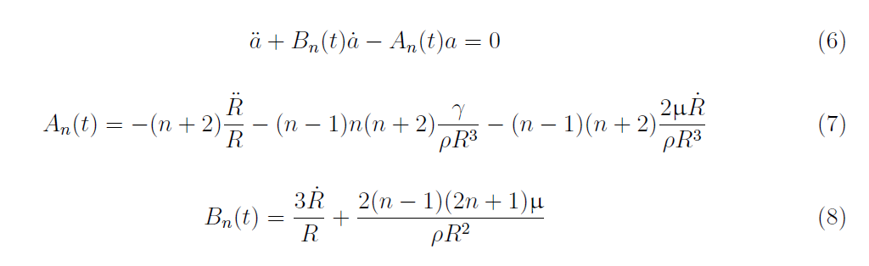
Surface Stability Equation
1. Problem 2. Red Blood Cell Context 3. Possible Solutions 4. Conclusion
Surface Stability Equation
or
Amplitude of Perturbation Equation

Slide 12
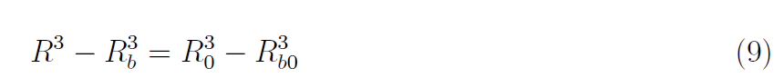
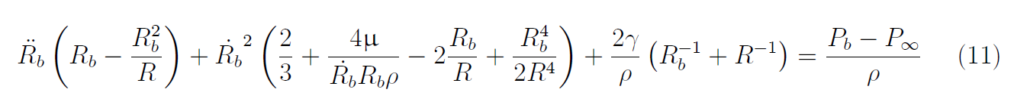
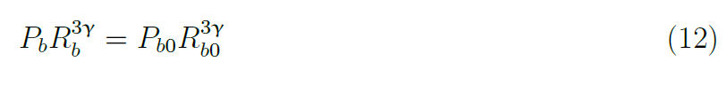
Relationship to Inner Surface
1. Problem 2. Red Blood Cell Context 3. Possible Solutions 4. Conclusion
Incompressible Fluid + Derivative
Unsteady non-linear Bernoulli equation
Adiabatic bubble surface relationship

Slide 13
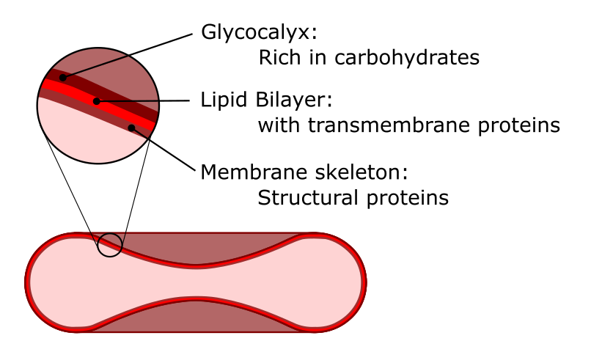
Reb Blood Cells
1. Problem 2. Red Blood Cell Context 3. Possible Solutions 4. Conclusion

Slide 14
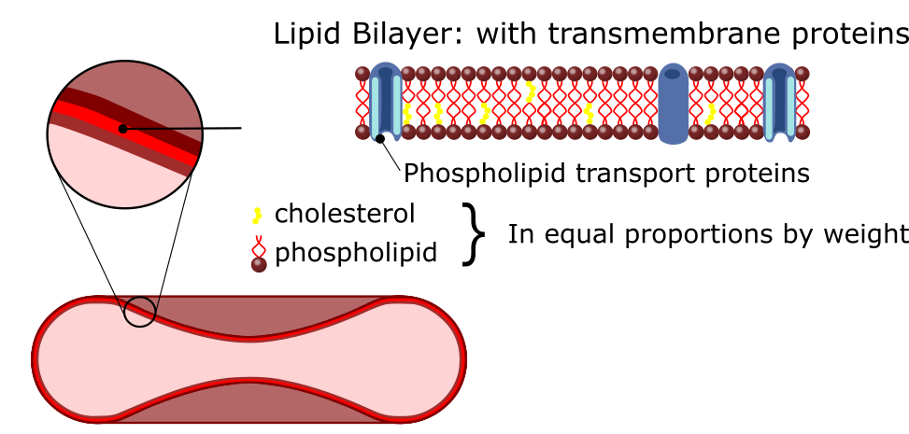
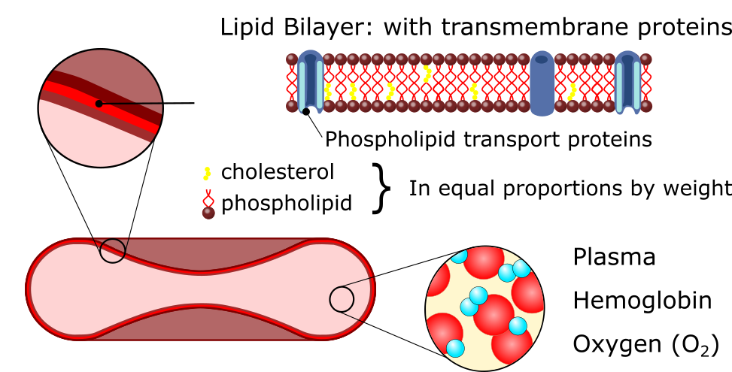
Reb Blood Cells
1. Problem 2. Red Blood Cell Context 3. Possible Solutions 4. Conclusion

Slide 15
Reb Blood Cells
1. Problem 2. Red Blood Cell Context 3. Possible Solutions 4. Conclusion
Hereditary Spherocytosis (HS): HS is a congenital RBC membrane disorder characterized by spherical RBCs that have reduced diameter and are intensely hemoglobinized^{[7]}. HS affects approximately 1 in 2,000 individuals of northern European ancestry ^{[19]}.

Slide 16
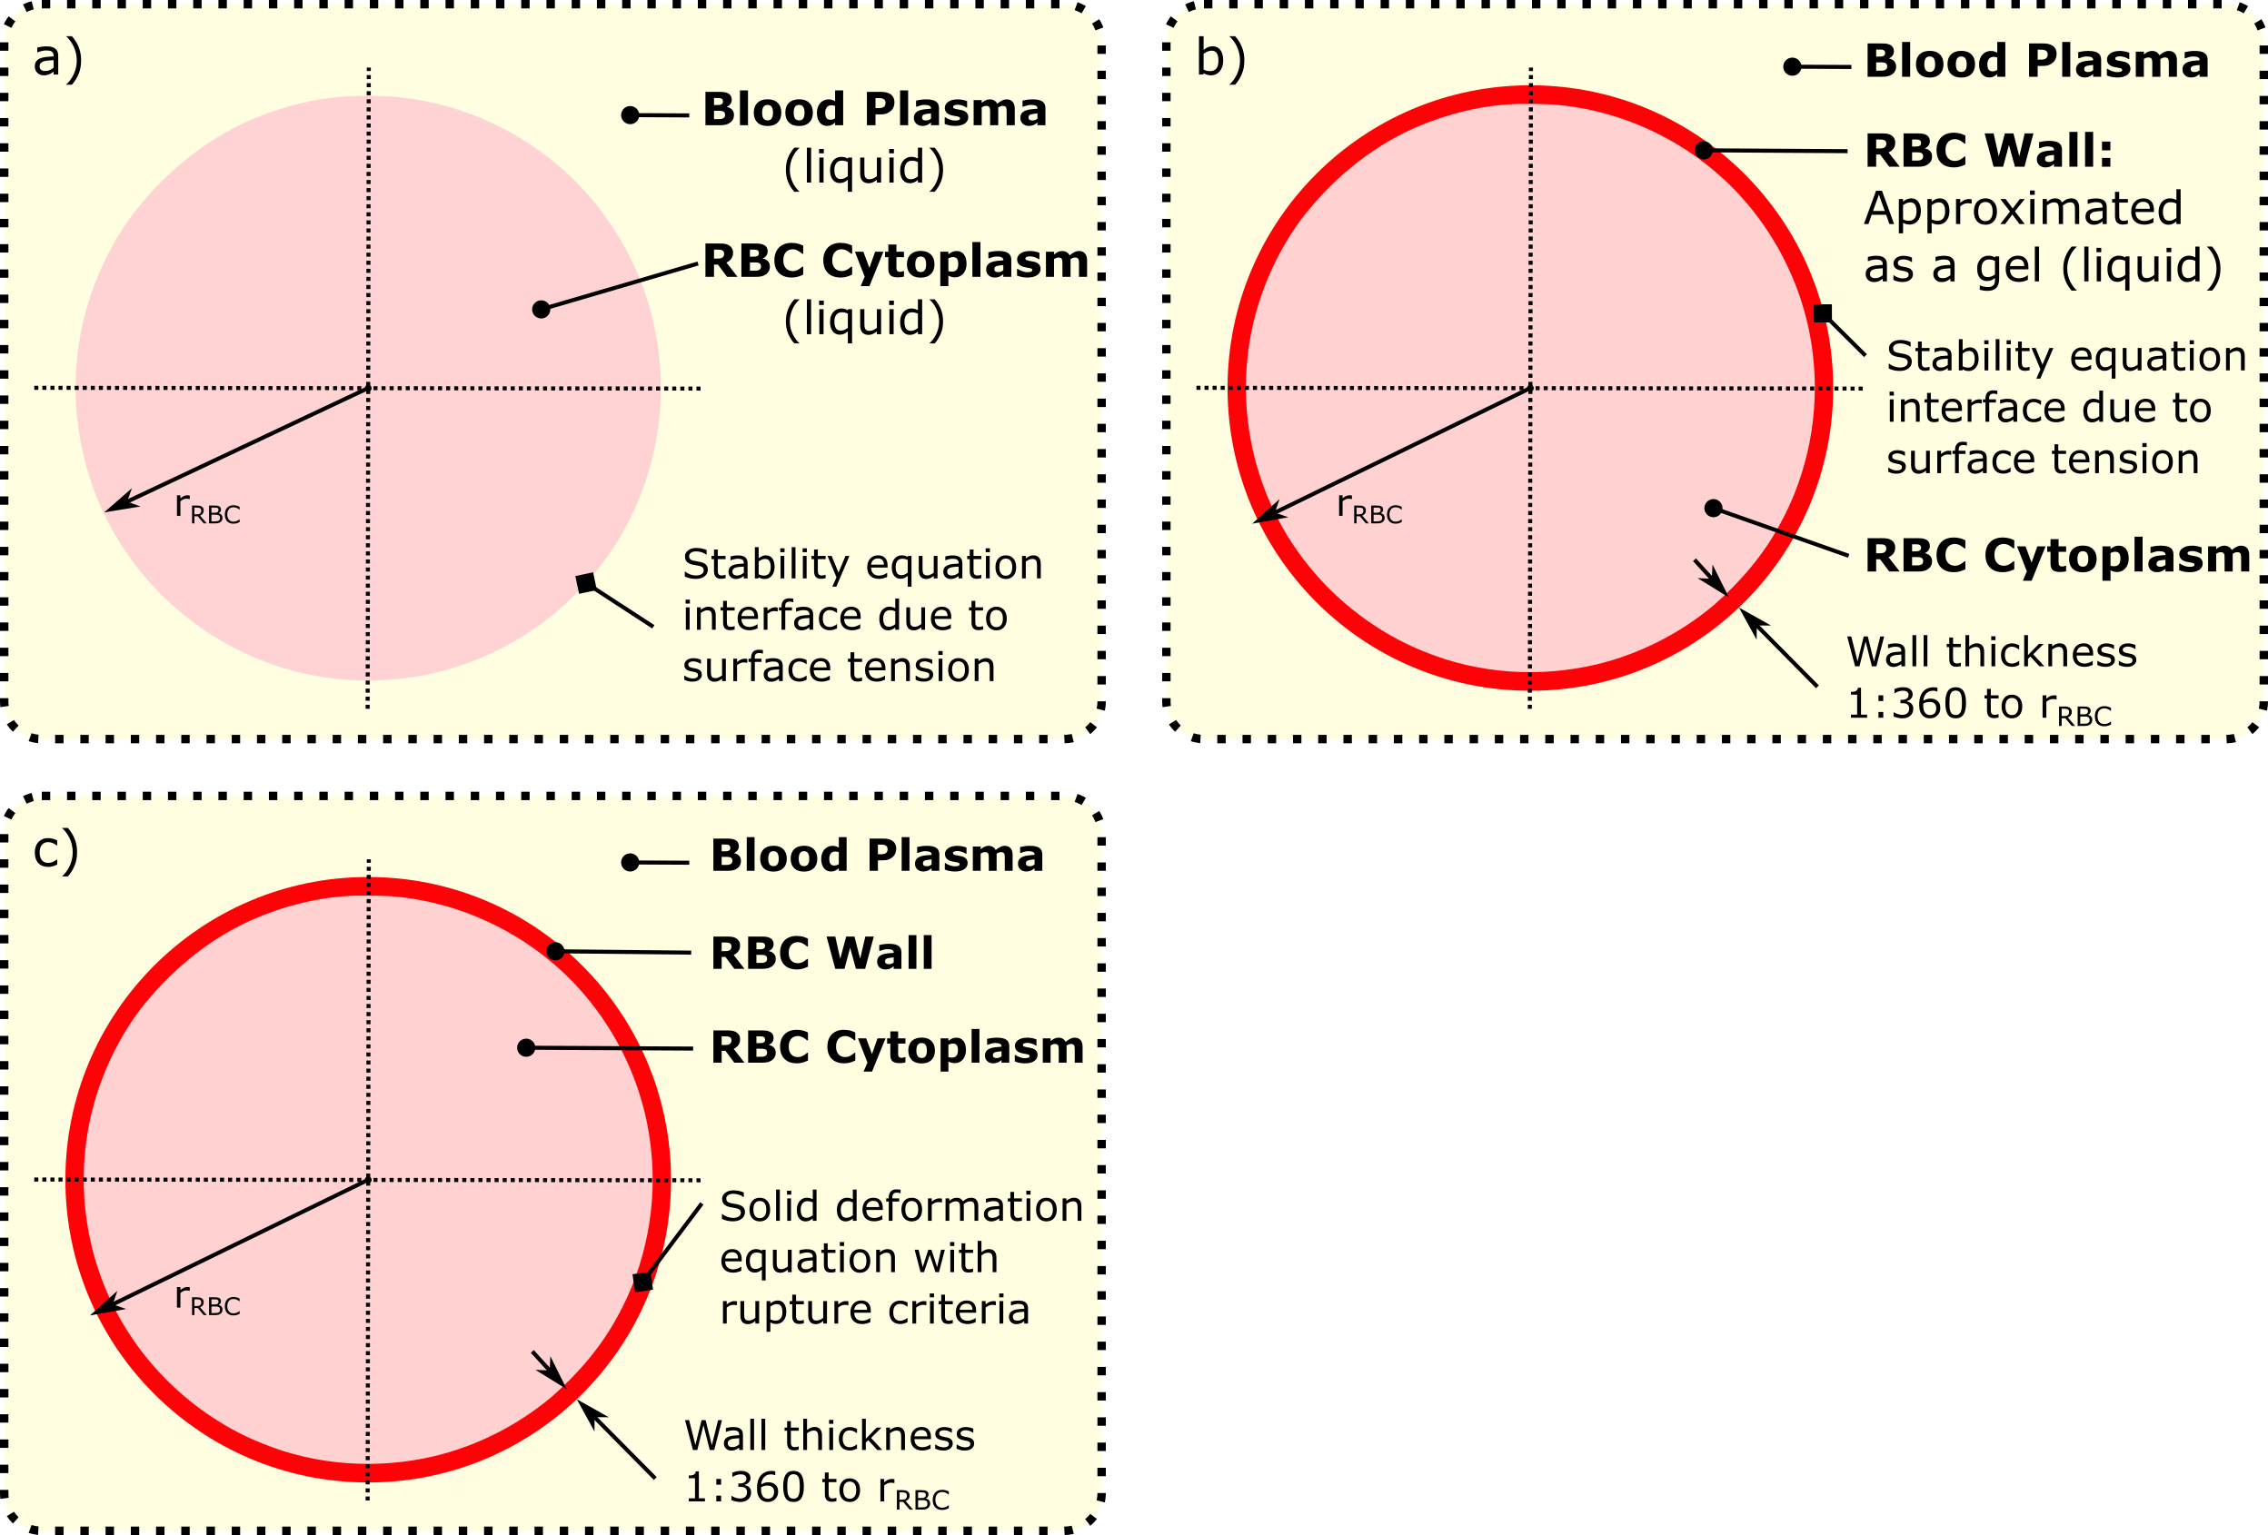
3 Possible Solutions
1. Problem 2. Red Blood Cell Context 3. Possible Solutions 4. Conclusion

Slide 17
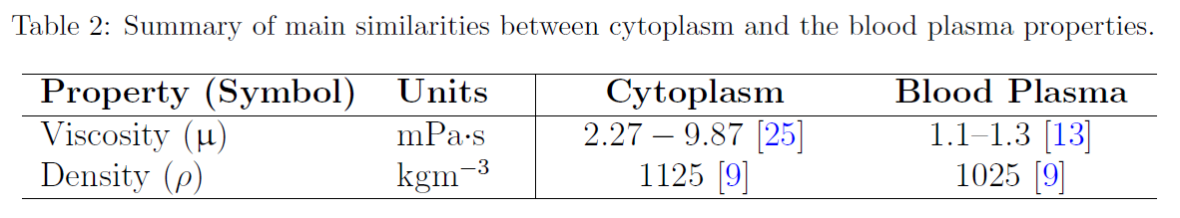
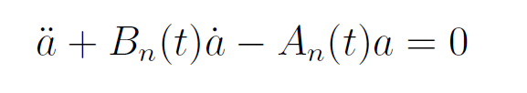
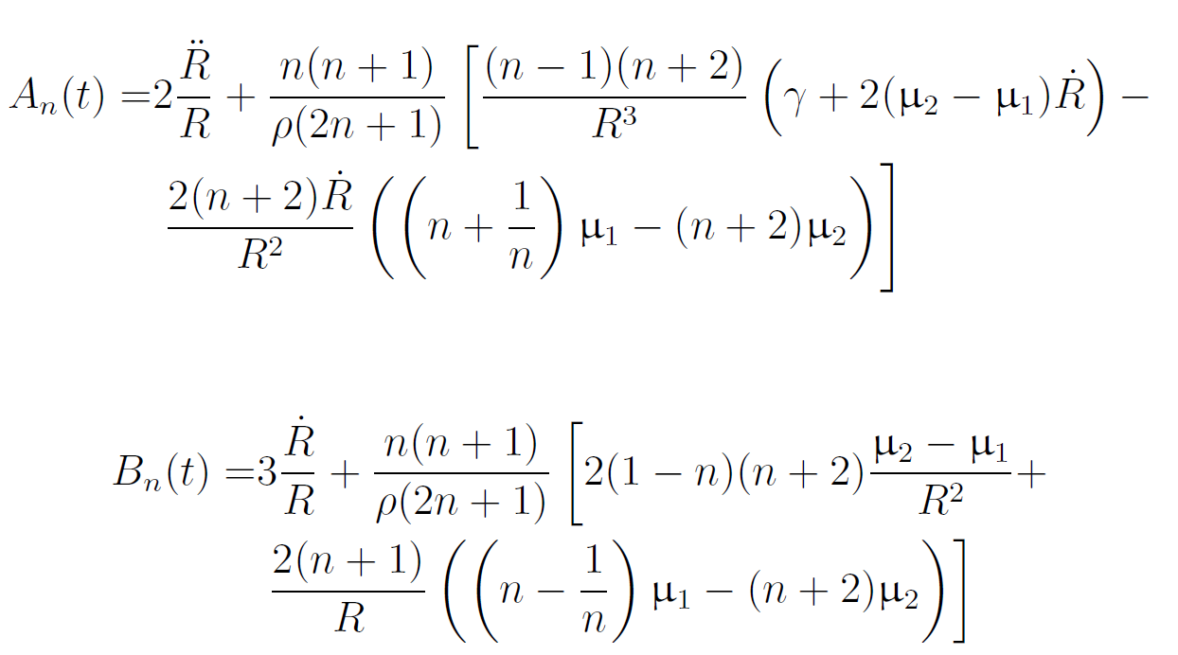
3 Possible Solutions: a)
1. Problem 2. Red Blood Cell Context 3. Possible Solutions 4. Conclusion
Benefits: Almost direct comparison to water droplet surface stability equation
Disadvantage: Least physiological of the cases

Slide 18
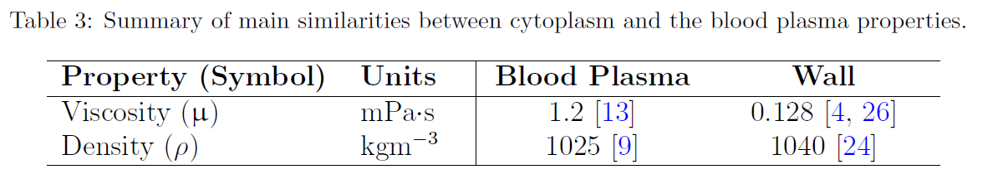
3 Possible Solutions: b)
1. Problem 2. Red Blood Cell Context 3. Possible Solutions 4. Conclusion
Benefits: Again, direct comparison to water droplet surface stability Equation
Disadvantage: Approximating the wall as a gel
Wall thickness is so small that it is likely to cause instabilities in solving – Need a fine mesh size / small time step
Use:
The same Surface Stability Equation from Option A
The same inner surface equations from the water droplet

Slide 19
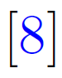
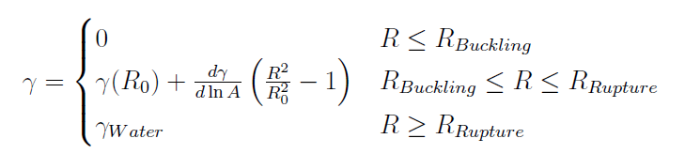
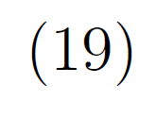
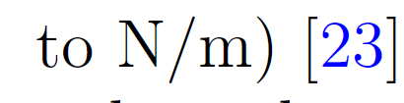
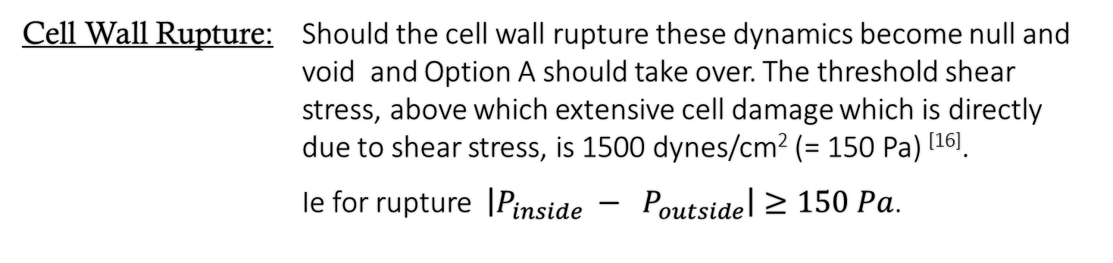
3 Possible Solutions: b)
1. Problem 2. Red Blood Cell Context 3. Possible Solutions 4. Conclusion
Surface Tension: Normally not obtainable, however
Cell Wall Rupture: Should the cell wall rupture these dynamics become null and void and Option A should take over. The threshold shear stress, above which extensive cell damage which is directly due to shear stress, is 1500 dynes/cm² (= 150 Pa) ^{[16]}.
Ie for rupture $\left|P_{inside} − P_{outside}\right|≥150 Pa$.

Slide 20
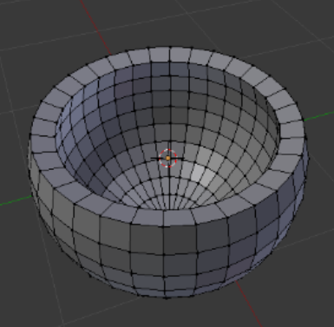
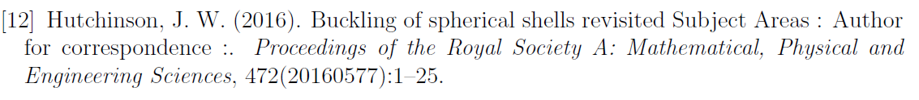
3 Possible Solutions: c)
1. Problem 2. Red Blood Cell Context 3. Possible Solutions 4. Conclusion
Benefits: Most physiological of the cases
Disadvantage: Computation time, Most intricate maths
Position Dependent,
Thin Wall Model: Donnell-Mushtari-Vlasov (DMV) ^{[12]} based upon the Kirchhoff-Love theory of plates as a two-dimensional mathematical model extension of the Euler-Bernoulli beam theory

Slide 21
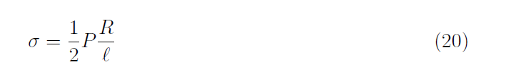
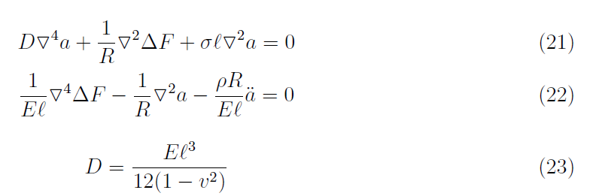
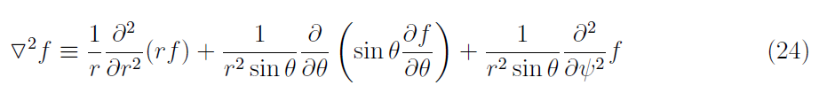
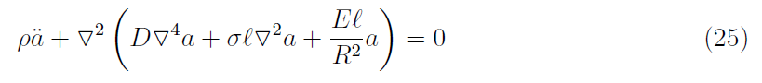
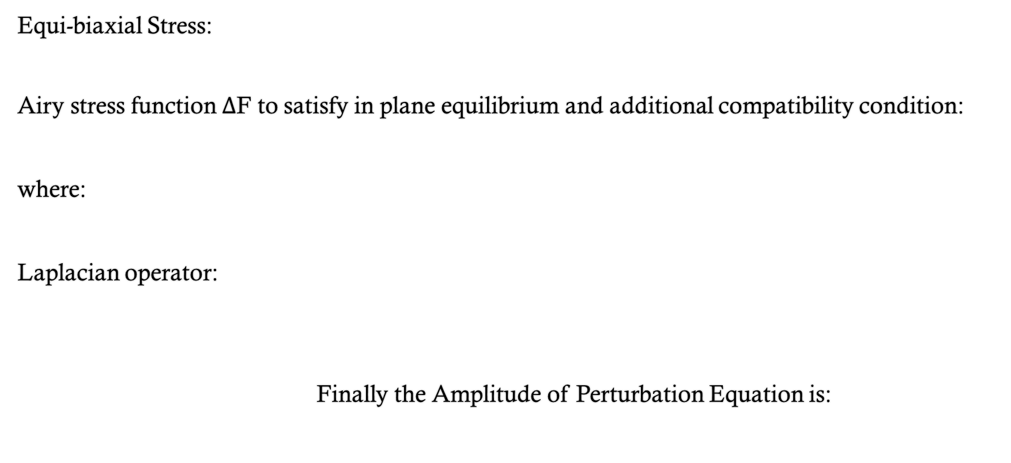
3 Possible Solutions: c)
1. Problem 2. Red Blood Cell Context 3. Possible Solutions 4. Conclusion
Equi-biaxial Stress:
Airy stress function $Δ$F to satisfy in plane equilibrium and additional compatibility condition:
where:
Laplacian operator:
Finally the Amplitude of Perturbation Equation is:

Slide 22
Conclusion
1. Problem 2. Red Blood Cell Context 3. Possible Solutions 4. Conclusion
Increase physiological relevance
Becomes more difficult to solve
Possible Future Work: Incorporating amplitude of perturbation equations with the entire sphere dynamics, Option A is trivial, Option B is somewhat easy but Option C is difficult
Comparison with raw data, without raw data of a RBC under deformation there is no way of validating the equations.

Slide 23



Come to New Zealand!
By Michelle Goodman
michellegoodman@hotmail.co.nz
michelle.goodman@canterbury.ac.nz

